Slide 1

Applying Optimization to NBA Lineups
Cameron Tomko

Slide 2

Business Problem
Analytics have helped teams identify players that impact winning
Goal of each NBA team is to assemble the best lineup yearly to potentially win the NBA Championship
Looking at the capacity of optimization in sports analytics and assess this through simulated games

Slide 3
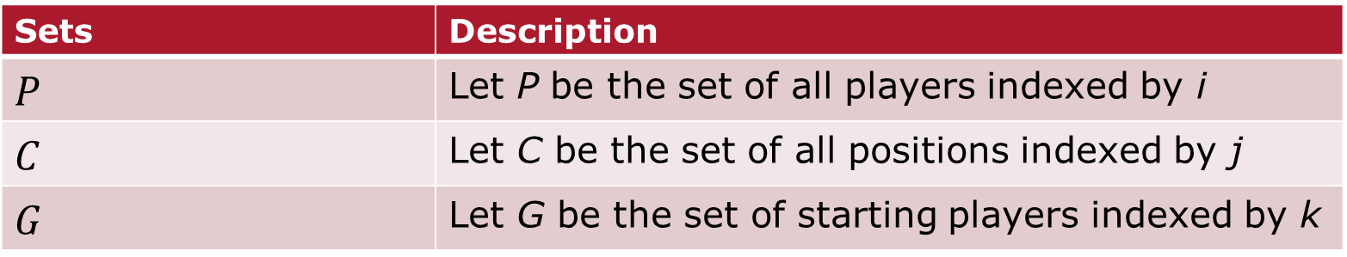
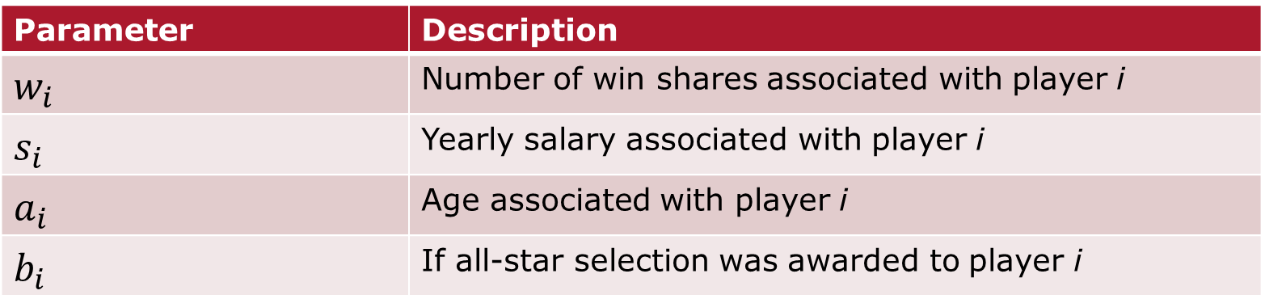
Sets, Decision Variables, and Parameters
Sets | Description
$$P$$ | Let P be the set of all players indexed by i
$$C$$ | Let C be the set of all positions indexed by j
$$G$$ | Let G be the set of starting players indexed by k
Decision Variables | Description
$$x_{i}$$ | 1 if the player is selected to the team
Parameter | Description
$$w_{i}$$ | Number of win shares associated with player i
$$s_{i}$$ | Yearly salary associated with player i
$$a_{i}$$ | Age associated with player i
$$b_{i}$$ | If all-star selection was awarded to player i

Slide 4
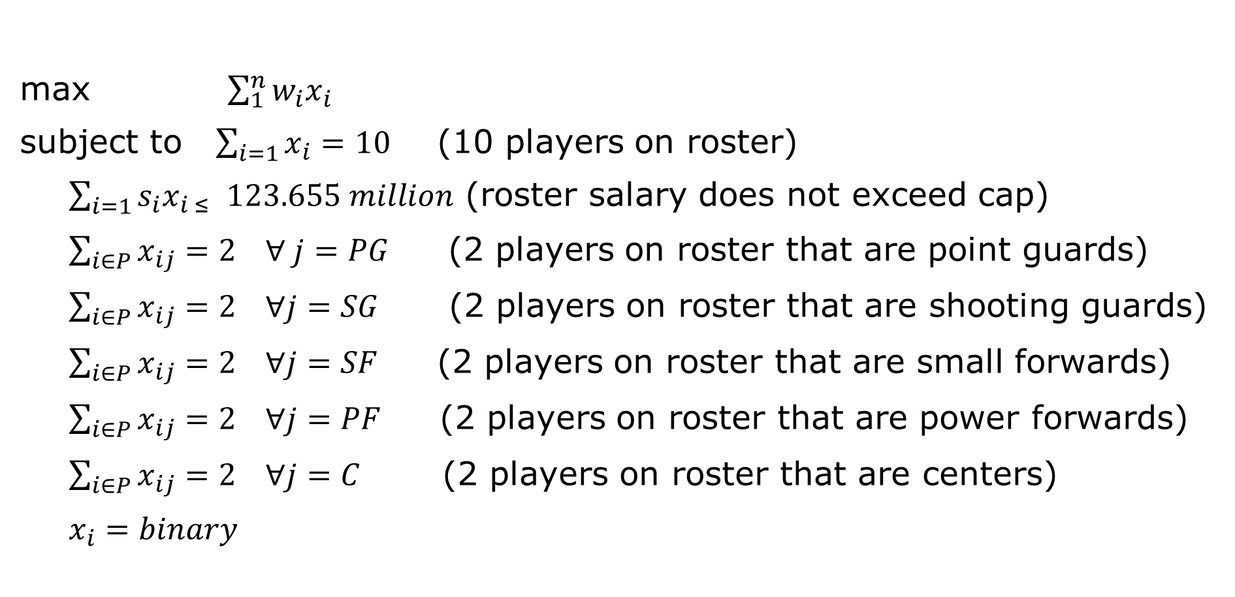
First Mathematical Model (Team #1)
max $\sum_{1}^{n}{w_{i}x_{i}}$
subject to $\sum_{i=1}{x_{i}}=10$ (10 players on roster)
$\sum_{i=1}{s_{i}x_{i ≤ }}123.655 million$ (roster salary does not exceed cap)
$\sum_{i∈P}{x_{ij}}=2 ∀ j=PG$ (2 players on roster that are point guards)
$\sum_{i∈P}{x_{ij}}=2 ∀j=SG$ (2 players on roster that are shooting guards)
$\sum_{i∈P}{x_{ij}}=2 ∀j=SF$ (2 players on roster that are small forwards)
$\sum_{i∈P}{x_{ij}}=2 ∀j=PF$ (2 players on roster that are power forwards)
$\sum_{i∈P}{x_{ij}}=2 ∀j=C$ (2 players on roster that are centers)
$x_{i}=binary$

Slide 5
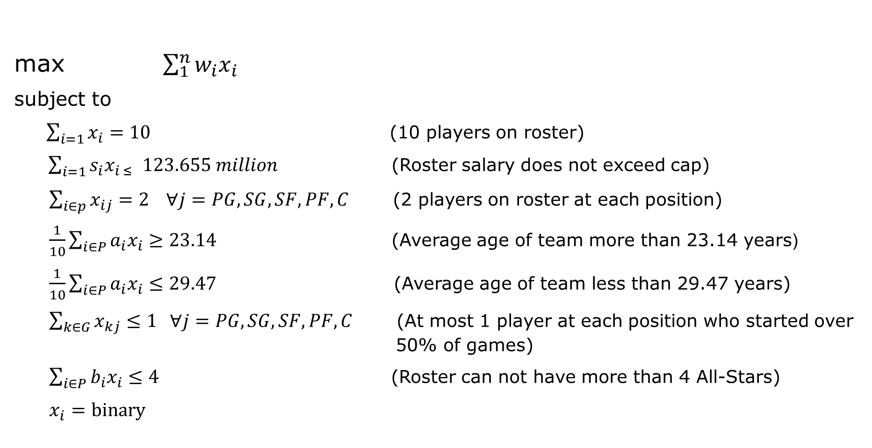
Final Mathematical Model (Team #2)
max $\sum_{1}^{n}{w_{i}x_{i}}$
subject to
$\sum_{i=1}{x_{i}}=10$ (10 players on roster)
$\sum_{i=1}{s_{i}x_{i ≤ }}123.655 million$ (Roster salary does not exceed cap)
$\sum_{i∈p}{x_{ij}}=2 ∀j=PG,SG, SF,PF,C$ (2 players on roster at each position)
$\frac{1}{10}\sum_{i∈P}{{a_{i}x}_{i}}≥23.14$ (Average age of team more than 23.14 years)
$\frac{1}{10}\sum_{i∈P}{{a_{i}x}_{i}}≤29.47$ (Average age of team less than 29.47 years)
$\sum_{k∈G}{x_{kj}}≤1 ∀j=PG,SG, SF,PF,C$ (At most 1 player at each position who started over 50% of games)
$\sum_{i∈P}{b_{i}x_{i}}≤4$ (Roster can not have more than 4 All-Stars)
$$x_{i}=binary$$

Slide 6
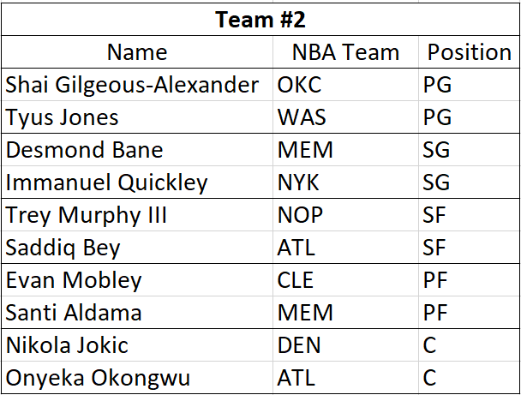
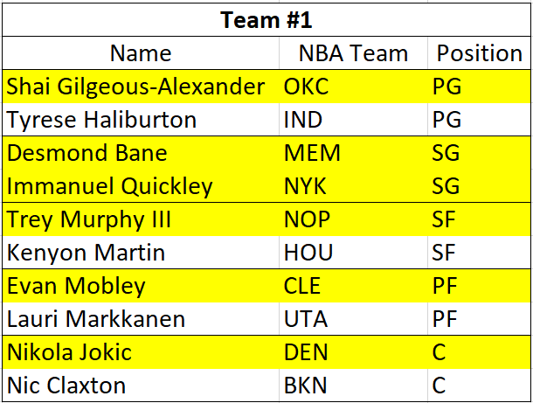
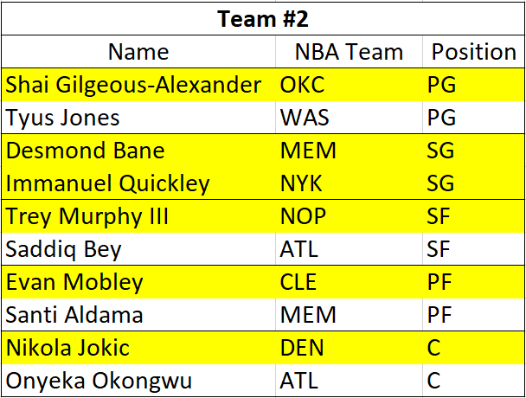
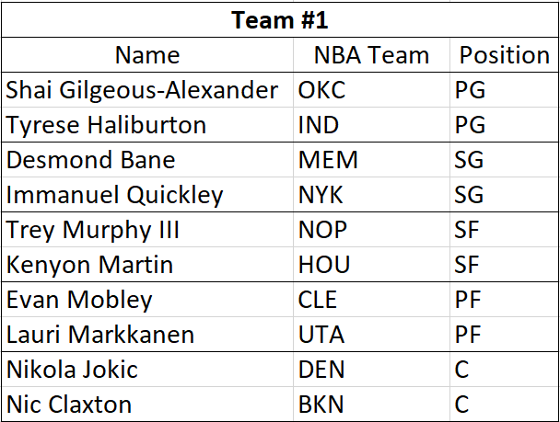
Optimization Model Results
Results of Team #1
Total Win Share: 84.8
Results of Team #2
Total Win Share: 76.2

Slide 7
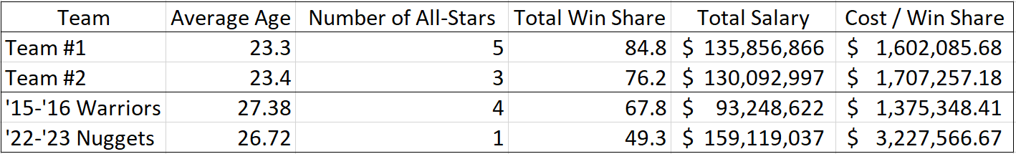
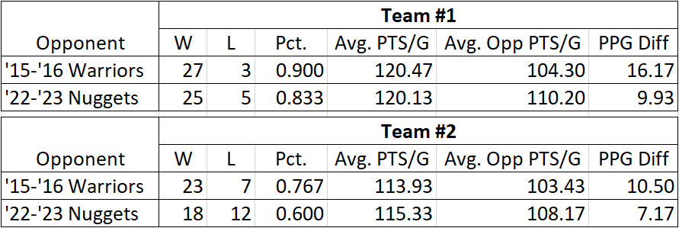
Simulation Results

Slide 8
Recommendations and Conclusion
Recommendations:
Add more constraints to create more realistic scenarios
Simulate an entire season to gauge success
Create model for longevity, not just optimizing for one year
Conclusions:
Based on success of optimized teams, there is clear representation of the use of analytics in sports as the optimized teams were able to compete against championship level teams

Slide 9
Thank you!

